Slide 1
HOTEL BOOKING CANCELLATION
BY:
PADMASARAN
ARAVINDH.S
MANSA
VENKATESH
LOKESH.R

Slide 2
PROBLEM STATEMENT
The booking details of a resort in Portugal between the 1st of July 2015 and 31st of August 2017 are provided. The resort is facing loss in revenue due to last minute cancellations by the customers resulting in the room lying vacant.

Slide 3
DATA DESCRIPTION
Name | Type | Description
Booking Changes | Numeric | Number of booking changes before arrival
Company | Categorical | ID of company (if an account was associated with it)
Country | Categorical | Country ISO identification of the main booking holder
CustomerType | Categorical | Type of customer (group, contract, transient, or transient-party)
DaysInWaitingList | Numeric | Number of days the booking was in a waiting list prior to confirmed availability and to being confirmed as a booking
DepositType | Categorical | Non-Refundable - payment made in full before the arrival date Refundable - partial payment before arrival was considered a “refundable” deposit No deposit – no prior payment made
DistributionChannel | Categorical | Name of the distribution channel used to make the booking
IsRepeatedGuest | Categorical | Outcome variable; binary value indicating if the booking was cancelled (0: no; 1: yes)
LeadTime | Numeric | Number of days prior to arrival that the booking was placed in the hotel
Name | Type | Description
Market Segment | Categorical | Market segmentation to which the booking was assigned
Meal | Categorical | ID of meal the guest requested
PreviousBookingsNotCanceled | Numeric | Number of previous bookings to this booking the guest had that were not cancelled
PreviousCancellations | Numeric | Number of previous bookings to this booking the guest had that were cancelled
RequiredCarParkingSpaces | Numeric | Number of car parking spaces the guest required
ReservedRoomTypes | Categorical | Room type requested by the guest
StaysInWeekendNights | Numeric | From the total length of stay, how many nights were in weekends (Saturday and Sunday)
StaysInWeekNights | Numeric | From the total length of stay, how many nights were in weekdays (Monday through Friday)
TotalOfSpecialRequests | Numeric | Number of special requests made (e.g., fruit basket, sea view, etc.)
Arrival Date Year | Numeric | Year of arrival
Reservation Status | Categorical | Reservation status of the room i.e. Cancelled, checked-out or no show.

Slide 4
DATA DESCRIPTION
Name | Type | Description
ADR | Numeric | Average Daily Rate
Adults | Numeric | Number of adults
Agents | Categorical | ID of the travel agency
ArrivalDateDayOfMonth | Numeric | Day of month of arrival
ArrivalDateMonth | Numeric | Date of arrival
ArrivalDateWeekNumber | Numeric | Week number of arrival date
AssignedRoomType | Categorical | Code for the type of room assigned
Babies | Numeric | Number of babies
Children | Numeric | Number of children
ReservationStatusDate | Categorical | Reservation status set date
Target Variable:
Is_Cancelled | Categorical | 0 – Not Cancelled 1 - Cancelled
Dataset size:
40060 rows and 31 features
Solution : Binary Classification

Slide 5
FEATURE ENGINEERING
Booking Date
Arrival date is created using the date, month and year columns.
Adults/Children
Column to show 1 if there are children or babies on the trip
Assigned/Reserved Room
There is a difference in reserved room vs assigned room.
Arrival Date subtracted from Lead Time gives the booking date
0 if there are only adults.
Here, 1 if rooms have been changed and 0, if rooms have not been changed

Slide 6
FEATURE ENGINEERING
Is_Holiday
Months which have national holidays are categorized to create is Holiday column
Family/Business
Column to show if it is a business or family trip
1 if it is a holiday and 0 if it is not a holiday
Business trip- Only adults, Family- Adults with children/babies

Slide 7
FEATURE ENGINEERING
Quarter
New column created to segregate months into four quarters ie. Quarter 1,2,3,4.
TotalStayinNights
Column to show total stay in nights
Obtained by combining columns StaysinWeekNights + StaysinWeekendNights

Slide 8
EXPLORATORY DATA ANALYSIS
Outlier Calculation:
Column name | Total | Outlier %
ADR | 1344 | 3.35
Adults | 8635 | 21.55
Babies | 548 | 1.36
BookingChanges | 7808 | 19.49
Children | 3484 | 8.69
DaysInWaitingList | 255 | 0.63
IsRepeatedGuest | 1778 | 4.43
LeadTime | 431 | 1.07
PreviousBookingsNotCanceled | 2032 | 5.07
PreviousCancellations | 1095 | 2.73
RequiredCarParkingSpaces | 5490 | 13.7
StaysInWeekNights | 232 | 0.57
StaysInWeekendNights | 183 | 0.45
Booking Changes seems to have a high outlier percentage of 19.49%
Adults has an outlier percentage of 21.55%
Outliers lying beyond 99 percentile in LeadTime feature has been removed

Slide 9
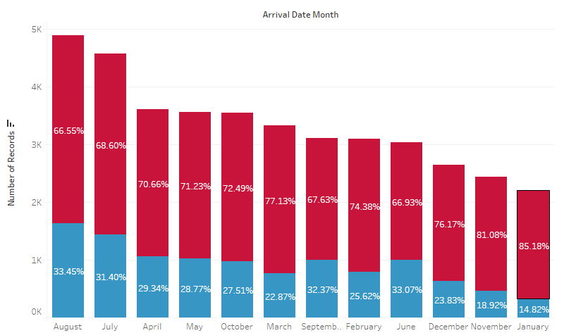
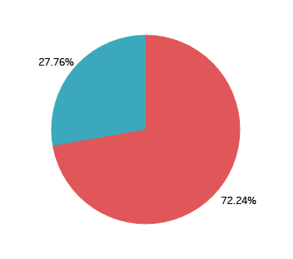

EXPLORATORY DATA ANALYSIS
Data imbalance
Plot showing no. of cancellations based on Month

Slide 10


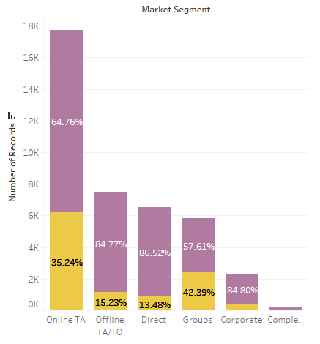
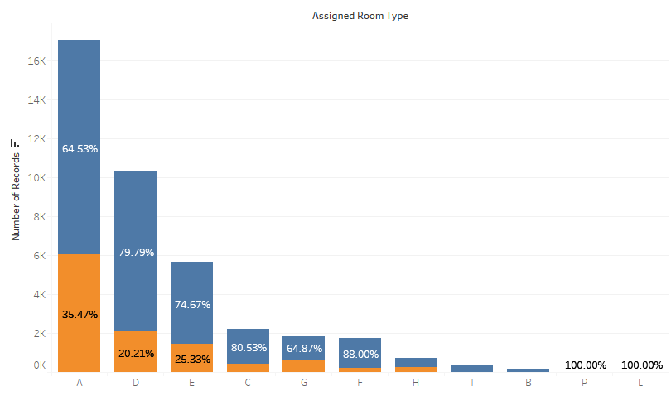
EXPLORATORY DATA ANALYSIS
No. of bookings based on Market Segment
No. of bookings based on Room Type

Slide 11
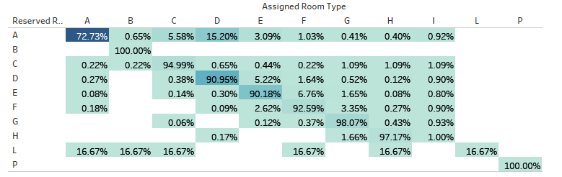
EXPLORATORY DATA ANALYSIS
Reserved Room vs Assigned Room

Slide 12
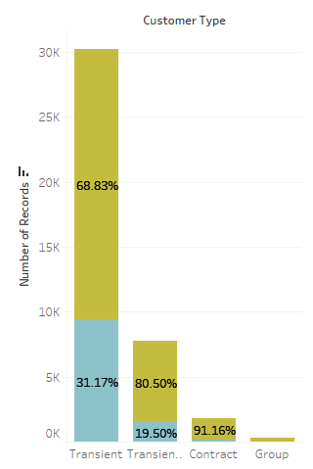
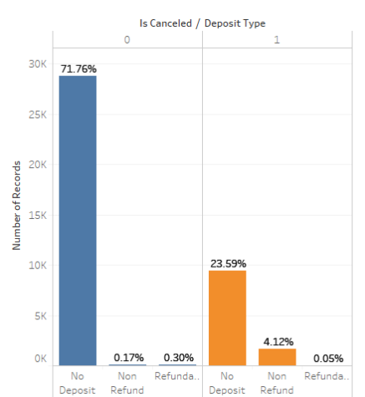

EXPLORATORY DATA ANALYSIS
No. of bookings/cancellations based on Customer Type
Cancellations based on Deposit type

Slide 13
EXPLORATORY DATA ANALYSIS
Statistical Significance:
ANOVA and chi-square test for independence were opted for testing the relation of numerical and categorical features respectively with the target classes.
So, strong inferences cannot be derived from these results.
Applying the tests, it was found that with exception to ‘Arrival date’ , all other features show statistically significant relationship with the target variable.

Slide 14
EXPLORATORY DATA ANALYSIS
Anova:
H₀ : The feature is not significant
H_{a} : The feature is significant
Feature | P value
LeadTime | 0.000000
ArrivalDateYear | 0.000000
ArrivalDateWeekNumber | 0.000015
ArrivalDateDayOfMonth | 0.060302
StaysInWeekendNights | 0.000000
StaysInWeekNights | 0.000000
Adults | 0.000000
Children | 0.000000
Babies | 0.000003
Feature | P value
IsRepeatedGuest | 0.000000
PreviousCancellations | 0.000000
PreviousBookingsNotCanceled | 0.000000
BookingChanges | 0.000000
DaysInWaitingList | 0.000000
ADR | 0.000000
RequiredCarParkingSpaces | 0.000000
TotalOfSpecialRequests | 0.000000

Slide 15
EXPLORATORY DATA ANALYSIS
Feature | P value
ArrivalDateMonth | 0.000000
Meal | 0.000000
Country | 0.000000
MarketSegment | 0.000000
DistributionChannel | 0.000000
ReservedRoomType | 0.000000
AssignedRoomType | 0.000000
DepositType | 0.000000
Agent | 0.000000
Company | 0.000000
CustomerType | 0.000000
ReservationStatus | 0.000000
ReservationStatusDate | 0.000000
Chi-Square Test:
H₀ : The feature is not significant
H_{a} : The feature is significant

Slide 16
EXPLORATORY DATA ANALYSIS
Multi-collinearlity:
On checking the relationship between the independent variables, Pearson’s coefficient was used which gives the strength of linear relationship between them.
Independent Variable 1 | Independent Variable 2 | Pearson’s Correlation Coefficient
StayInWeekNights | StaysInWeekendNights | 0.72
StayInWeekNights | Lead Time | 0.39

Slide 17
EXPLORATORY DATA ANALYSIS
Columns to be dropped:
ReservationStatus
ReservationStatusDate
MarketSegment
ReservedRoomType
ArrivalDateMonth
StaysInWeekNights
ArrivalDateWeekNumber
Children

Slide 18
ENCODING CATEGORICAL COLUMNS
Countries:
Is Cancelled | Non- Cancelled Percentage | Cancelled Percentage
PRT | 0.578106 | 0.421894
CHE | 0.742529 | 0.257471
BRA | 0.765116 | 0.234884
ESP | 0.784938 | 0.215062
IRL | 0.800554 | 0.199446
ITA | 0.825708 | 0.174292
USA | 0.849687 | 0.150313
CN | 0.864789 | 0.135211
BEL | 0.868304 | 0.131696
FRA | 0.869025 | 0.130975
GBR | 0.869240 | 0.130760
DEU | 0.878637 | 0.121363
NLD | 0.891051 | 0.108949
Is Cancelled | Cancelled Percentage | Created Labels
PRT | 0.421894 | Portugal
CHE | 0.257471 | High
BRA | 0.234884
ESP | 0.215062
IRL | 0.199446
ITA | 0.174292
USA | 0.150313
CN | 0.135211 | Low
BEL | 0.131696
FRA | 0.130975
GBR | 0.130760
DEU | 0.121363
NLD | 0.108949

Slide 19
ENCODING CATEGORICAL COLUMNS
Agents:
Companies:
Is Cancelled | 0 | 1
242 | 0.930000 | 0.070000
96 | 0.938462 | 0.061538
NULL | 0.941647 | 0.058353
250 | 0.943489 | 0.056511
240 | 0.959034 | 0.040966
243 | 0.966102 | 0.033898
298 | 0.972603 | 0.027397
40 | 0.974359 | 0.025641
6 | 0.976271 | 0.023729
241 | 0.979757 | 0.020243
314 | 1.000000 | 0.000000
Is Cancelled | 0 | 1
NULL | 0.710029 | 0.289971
223 | 0.848214 | 0.151786
281 | 0.876812 | 0.123188
154 | 0.962406 | 0.037594

Slide 20
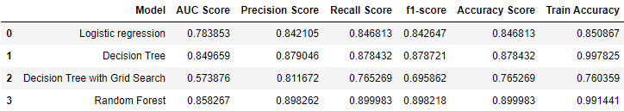
MODELLING
WITHOUT FEATURE SELECTION

Slide 21
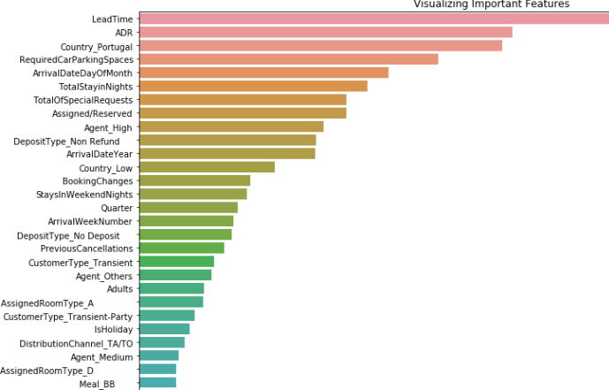
FEATURE SELECTION

Slide 22
FEATURE SELECTION
S.No. | Random Forest | RFE
1 | LeadTime | LeadTime
2 | Country_Portugal | Country_Portugal
3 | ADR | ADR
4 | RequiredCarParkingSpaces | RequiredCarParkingSpaces
5 | ArrivalDateDayOfMonth | ArrivalDateDayOfMonth
6 | Agent_High | Agent_High
7 | Assigned/Reserved | Assigned/Reserved
8 | TotalStayinNights | TotalStayinNights
9 | TotalOfSpecialRequests | TotalOfSpecialRequests
10 | ArrivalDateYear | ArrivalDateYear
11 | DepositType_No Deposit | DepositType_No Deposit
12 | Country_Low | Country_Low
13 | DepositType_Non Refund | DepositType_Non Refund
S.No. | Random Forest | RFE
14 | StaysInWeekendNights | StaysInWeekendNights
15 | BookingChanges | BookingChanges
16 | Quarter | Quarter
17 | ArrivalWeekNumber | ArrivalWeekNumber
18 | PreviousCancellations | PreviousCancellations
19 | CustomerType_Transient | CustomerType_Transient
20 | Agent_Low | Agent_Low
21 | CustomerType_Transient-Party | CustomerType_Transient-Party
22 | DistributionChannel_TA/TO | Meal_HB
23 | Adults | Adults
24 | DistributionChannel_Direct | DistributionChannel_Direct
25 | IsHoliday | IsHoliday
26 | AssignedRoomType_A | AssignedRoomType_A

Slide 23
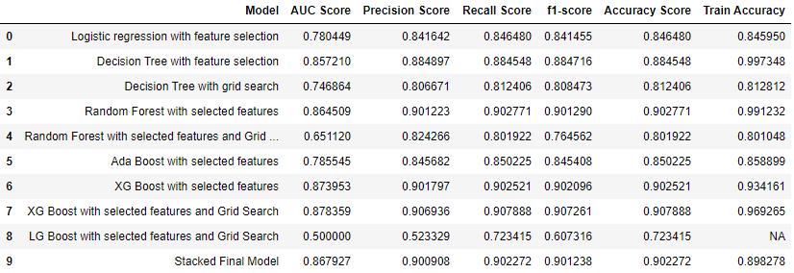
MODELLING
AFTER FEATURE SELECTION

Slide 24
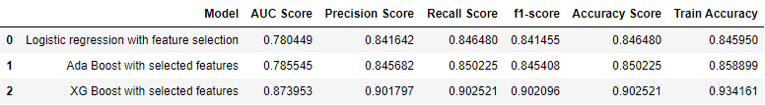
FINAL MODEL
From the above table, it is evident that the best model is Stacking Classifier with an accuracy of 90%.
The algorithms used in stacking classifier are:
Logistic Regression, Ada Boost and XG Boost Classifier on the first level
XG Boost Classifier on the second level.

Slide 25
CONCLUSION
The likelihood of a booking to be cancelled has thus been determined based on the models built with an accuracy of 90%.
These prediction models enable hotel managers to mitigate revenue loss derived from booking cancellations.
Booking cancellations models also allow hotel managers to implement less rigid cancellation policies, without increasing uncertainty. This has the potential to translate into more sales, since less rigid cancellation policies generate more bookings.

Slide 26
THANKS!

